Slide 1
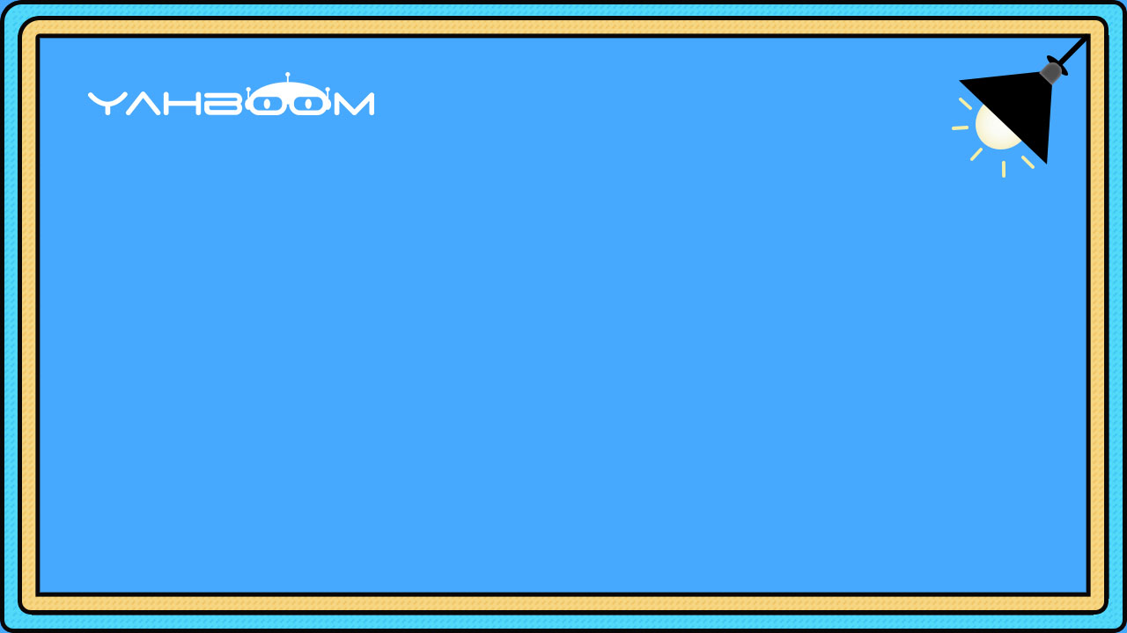

micro:bit programming tutorial
Lesson 15
micro:bit basic lesson 15“Color adjuster”
Yahboom micro:bit tutorial

Slide 2
micro:bit programming tutorial
Part1
Part 2
Part3
Part 4
Part 5
Learning goals
Preparation
Search for blocks
Combine blocks
Have a try
Yahboom micro:bit tutorial

Slide 3
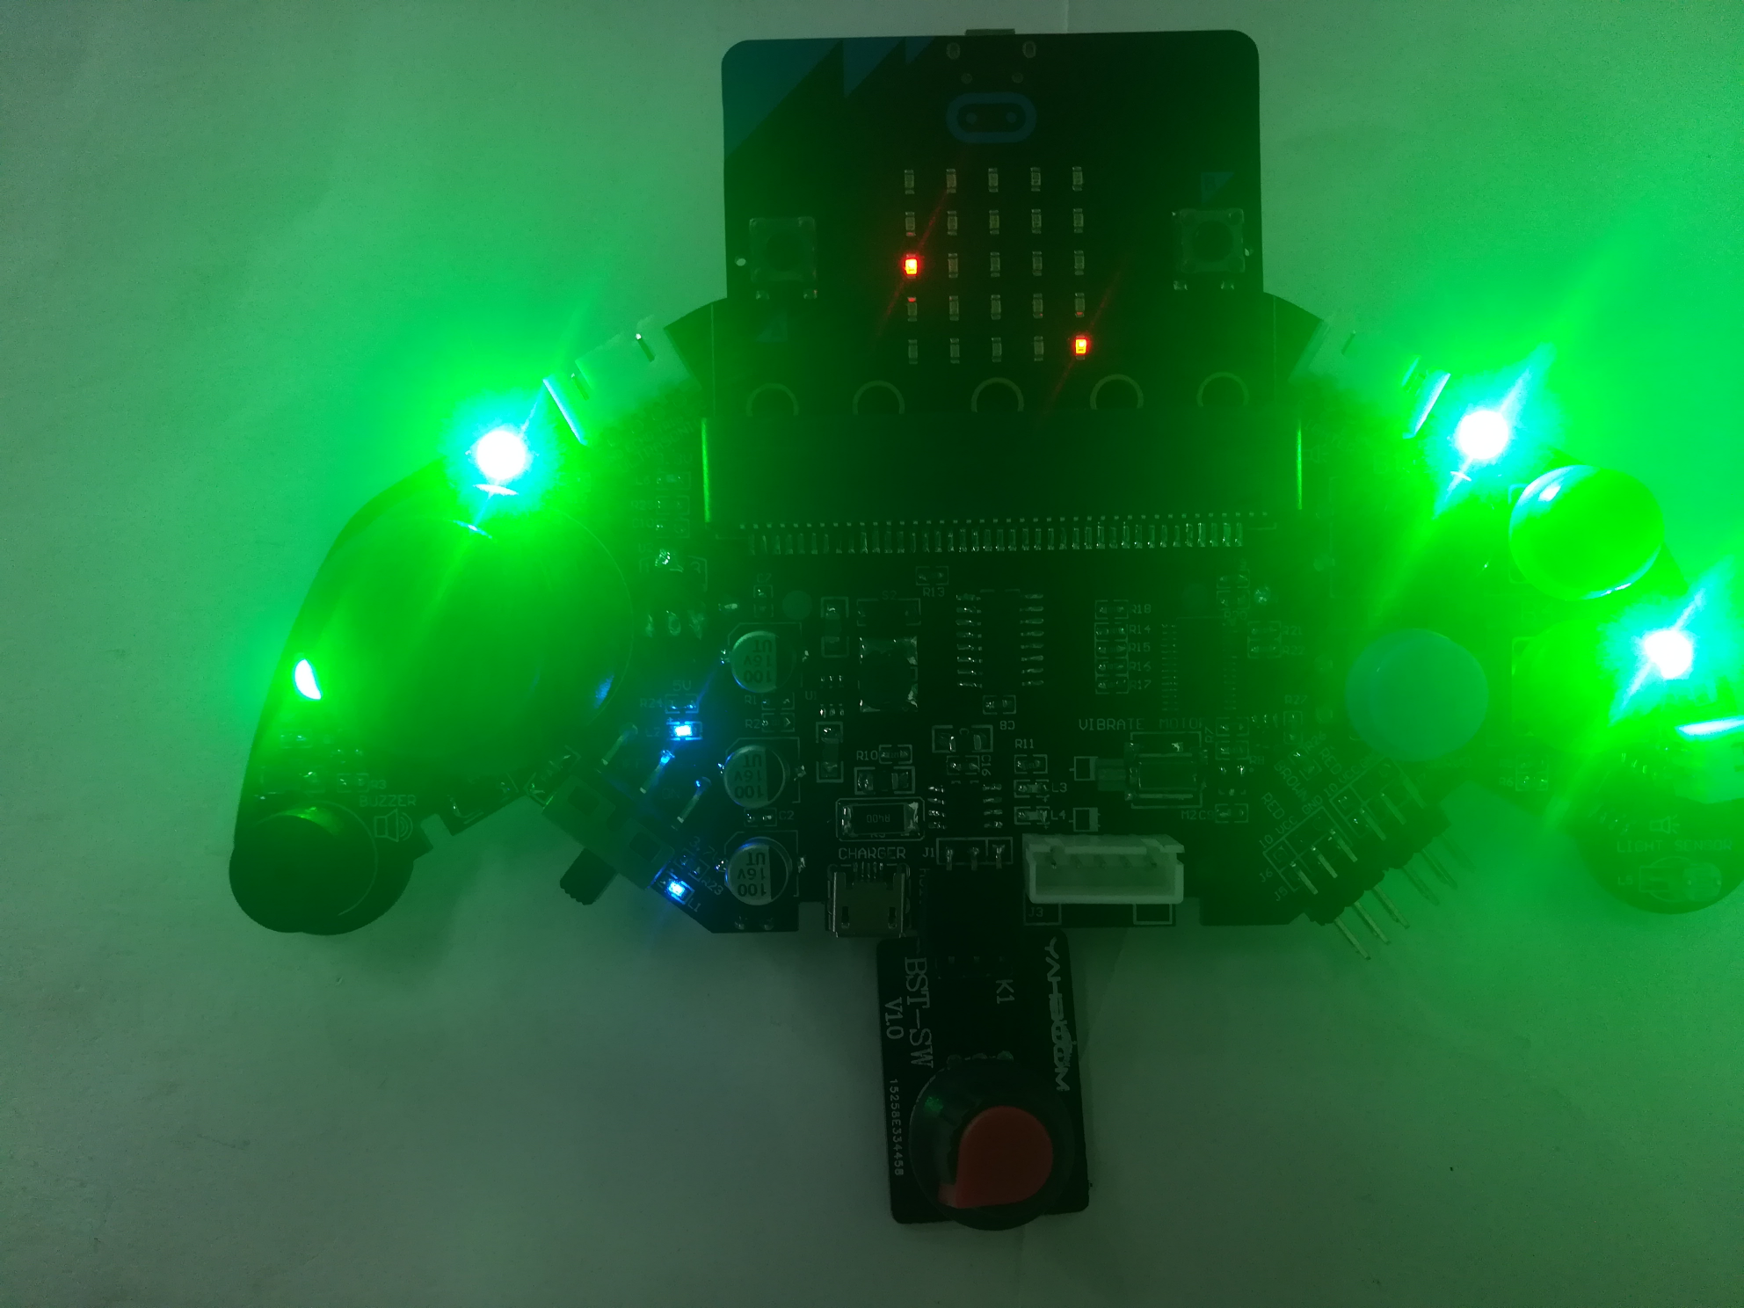
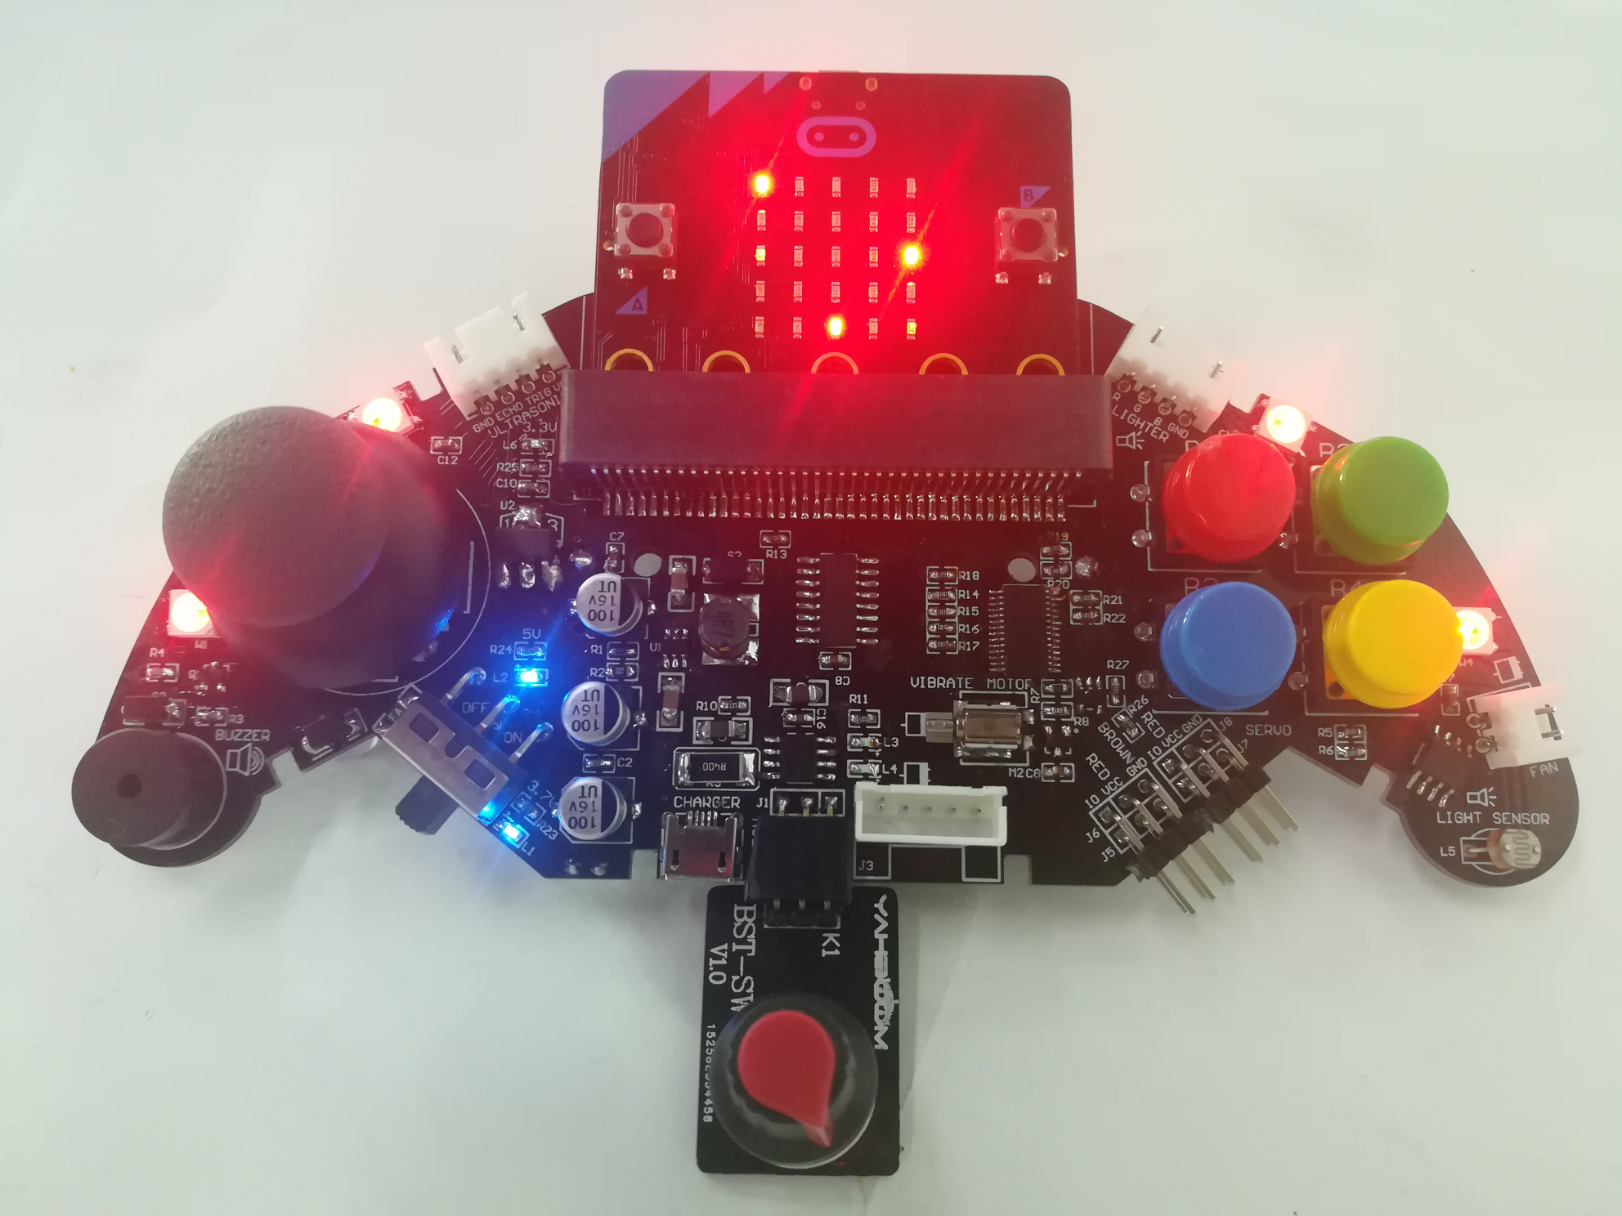
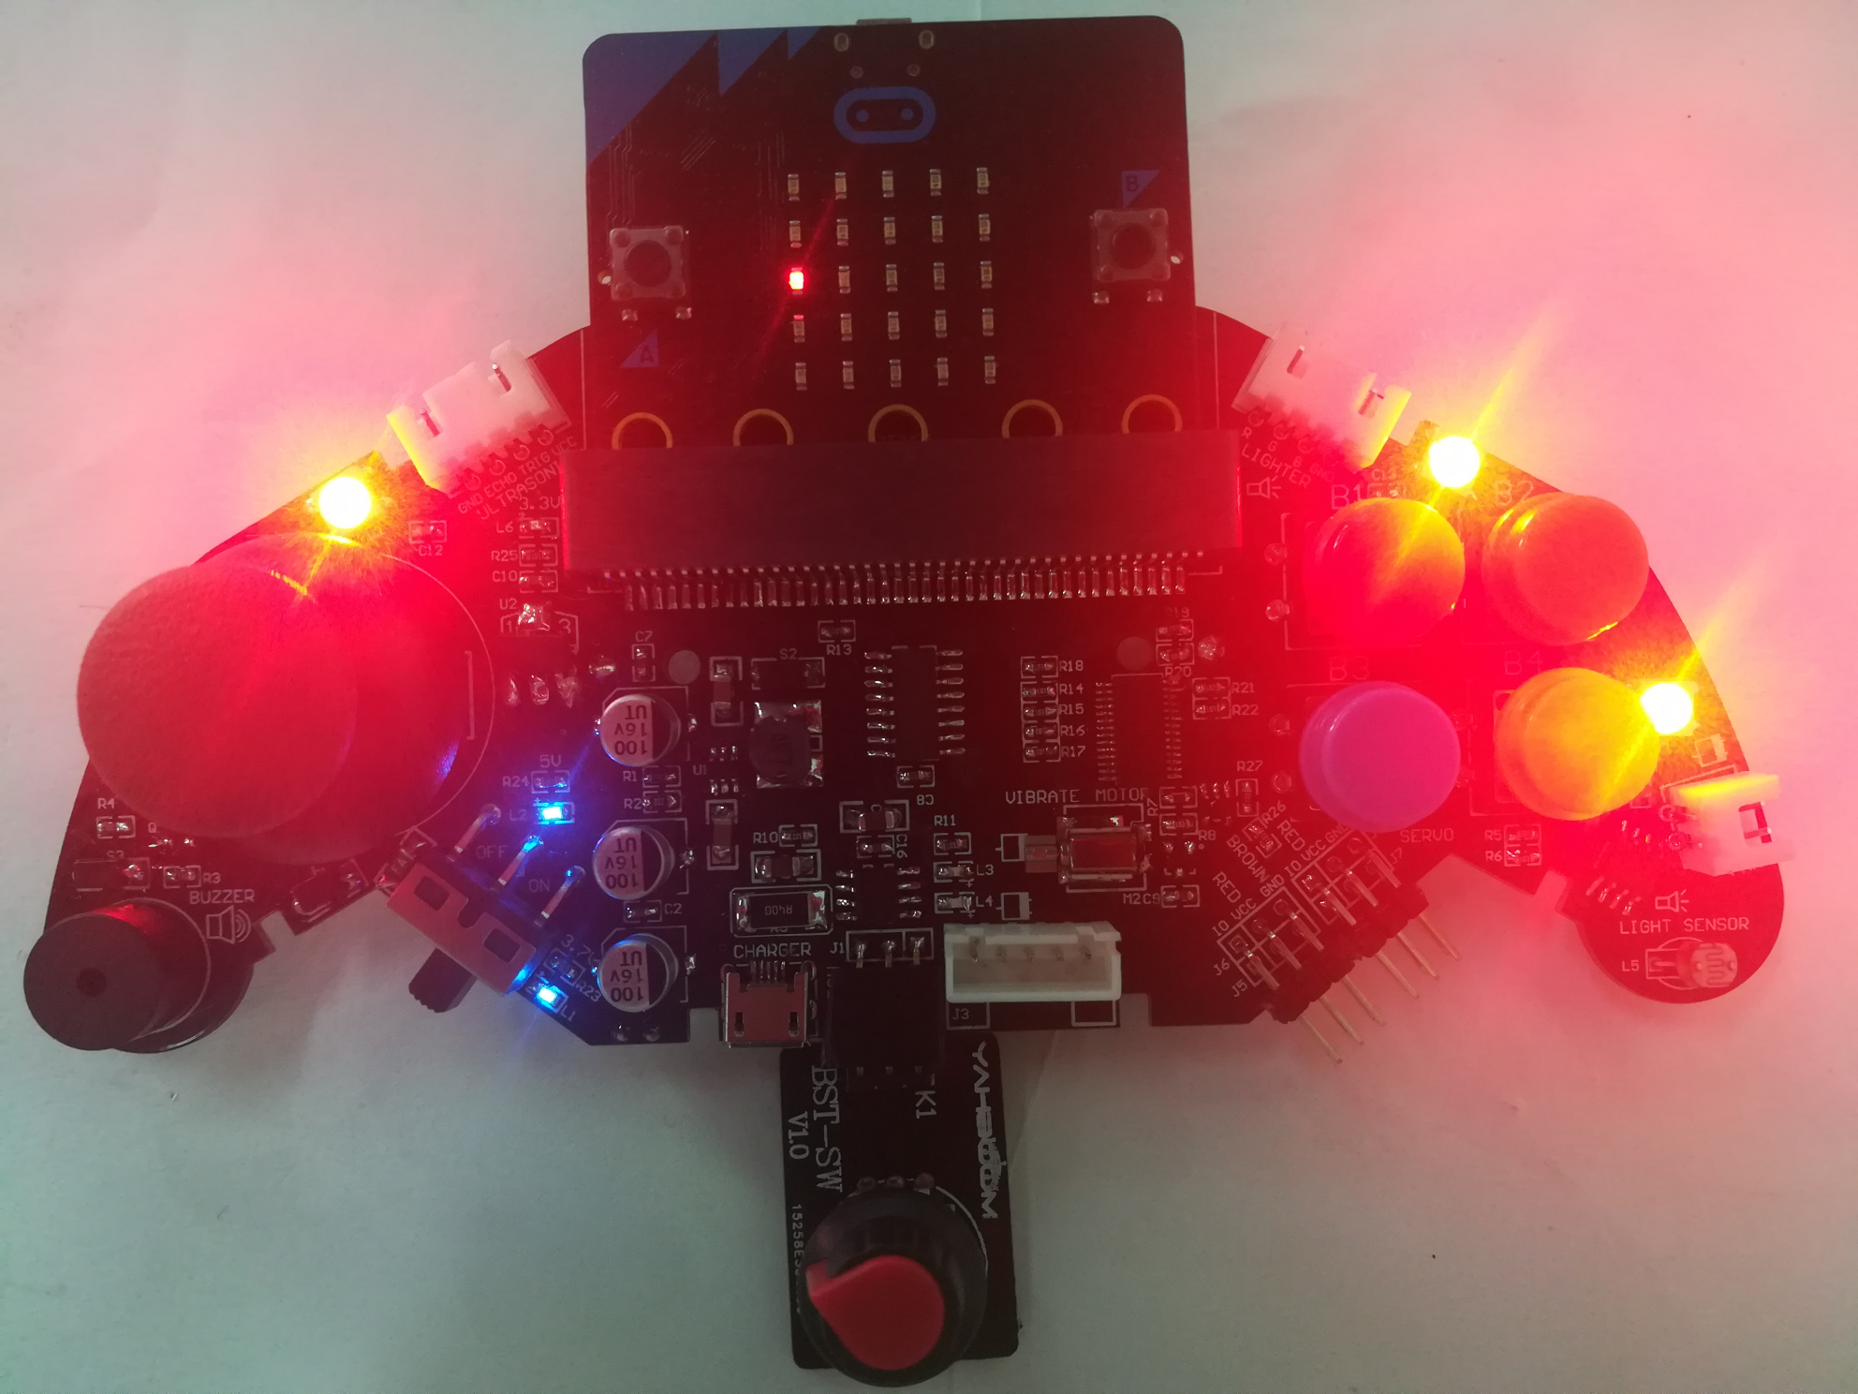
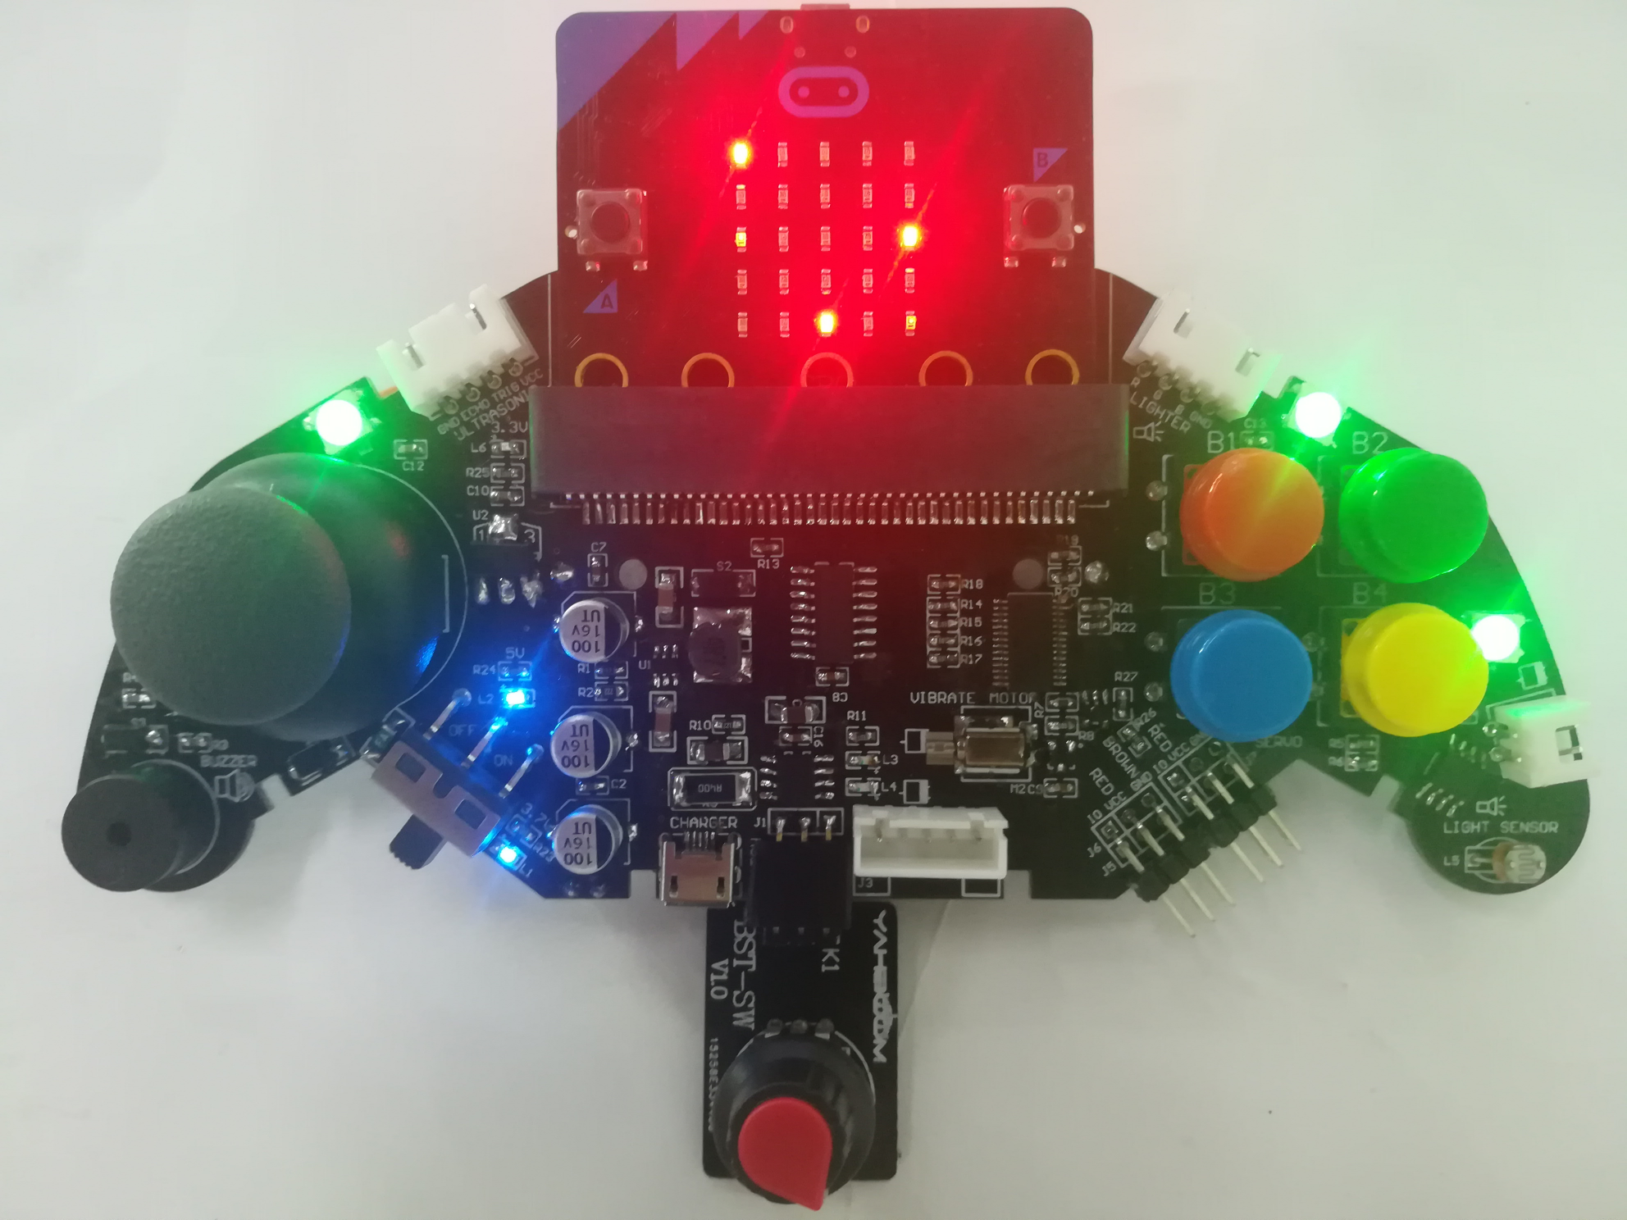
micro:bit programming tutorial
Part1
When one of the four buttons on the handle is pressed, the colored light on the handle will illuminate the corresponding color of the button. Rotate the knob potentiometer at the bottom of the handle and the lamp brightness will be adjusted accordingly.
Yahboom micro:bit tutorial

Slide 4
micro:bit programming tutorial
Part2
Hardware：
● 1 X micro:bit Game Handle
● 1 X Micro USB Cable
● 1 X Knob potentiometer
Yahboom micro:bit tutorial

Slide 5
micro:bit programming tutorial
Two programming methods
Part2
1.Online: Connect Micro:bit to the computer via USB cable, and the computer will pop up a U disk and click the URL in the U disk to enter the programming interface.Enter this URL https://github.com/lzty634158/GHBit to get the package named GHBit.
2.offline：Open micro:bit offline programming software and add GHBit package.Click on "Advanced" and select "Add Package".Enter this URL https://github.com/lzty634158/GHBit to get the package named GHBit.
Note: If you already have a GHBit package, you don't need to add it repeatedly.
Yahboom micro:bit tutorial

Slide 6
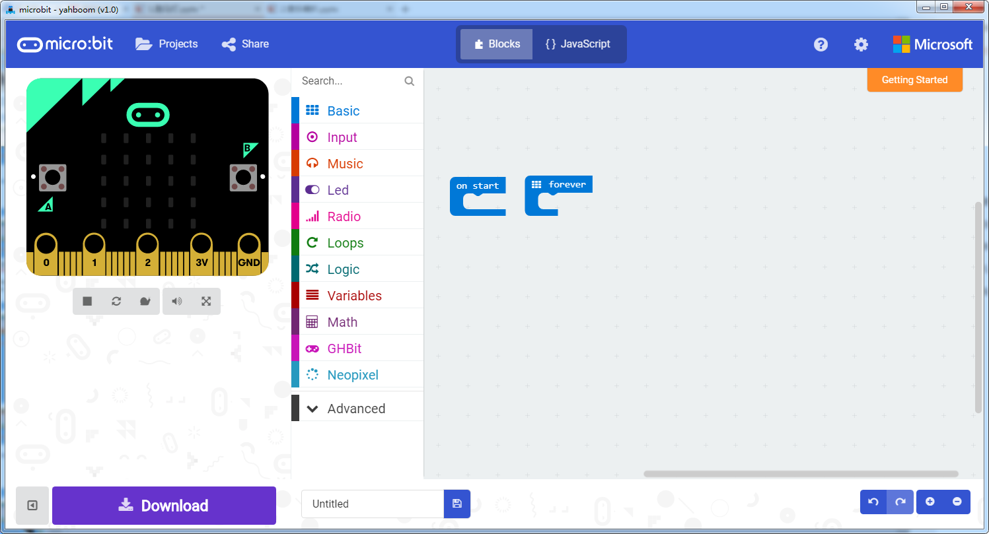
micro:bit programming tutorial
Programming interface
Part3
Yahboom micro:bit tutorial

Slide 7
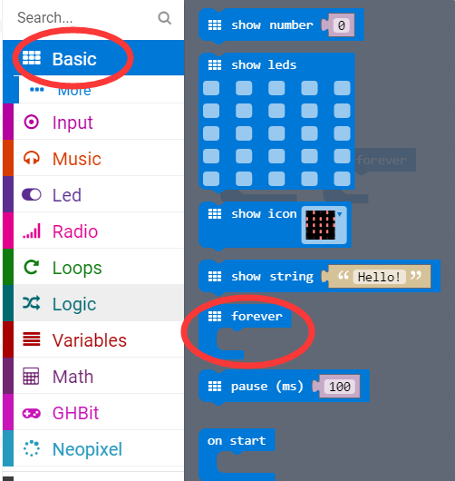
micro:bit programming tutorial
Part3
Start programming
The “forever” building block means that when the micro:bi Game Handle is turned on, the blocks in “forever” are repeatedly executed.
Yahboom micro:bit tutorial

Slide 8
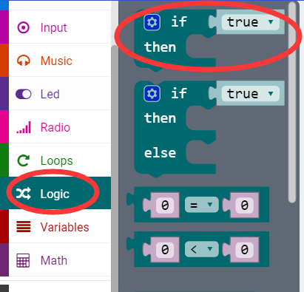
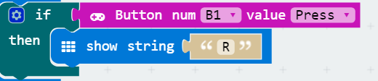
micro:bit programming tutorial
Part3
If a value is true, then do some statements.
For example: If the B1 button of the handle is pressed, the dot matrix display character R is executed. If the B1 button is not pressed, it will not be executed.
Yahboom micro:bit tutorial

Slide 9
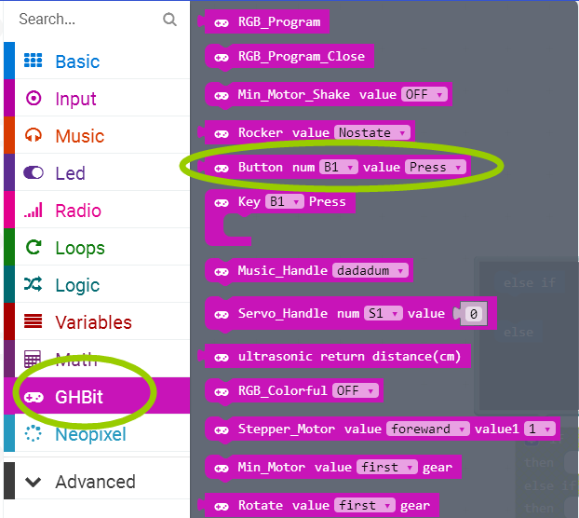
micro:bit programming tutorial
Part3
This is a building block about the keys. You can choose different keys to indicate that when this button is pressed, this building block can be combined with the "if then" building block.
Yahboom micro:bit tutorial

Slide 10
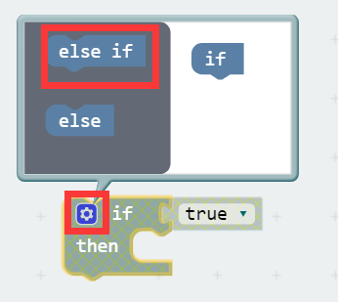
micro:bit programming tutorial
Part3
When there are many choices, you can click on the pinion above. Drag the "else if" on the left to the bottom of the "if" on the right, and click on the pinion again.
Yahboom micro:bit tutorial

Slide 11
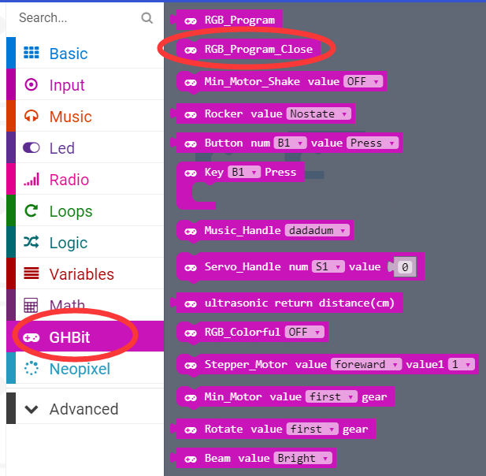
micro:bit programming tutorial
Part3
Turn off the colorful lights.
Note: Every time you complete an experiment on a colorful light, you need to use a program that turns off the colorful lights. Otherwise the colorful lights will remain on.
Yahboom micro:bit tutorial

Slide 12
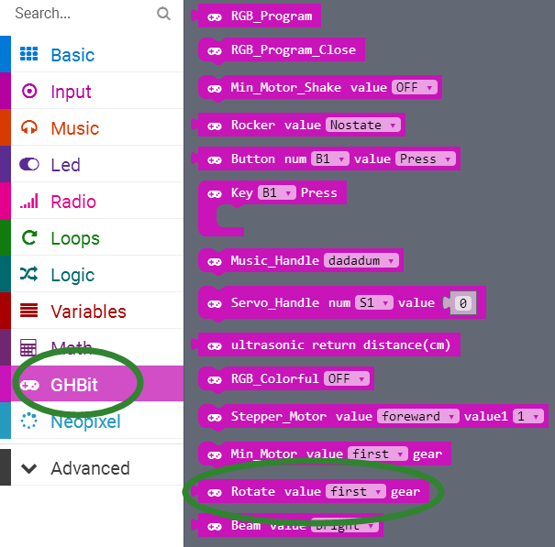
micro:bit programming tutorial
Part3
Set the angle of the knob potentiometer.
Yahboom micro:bit tutorial

Slide 13
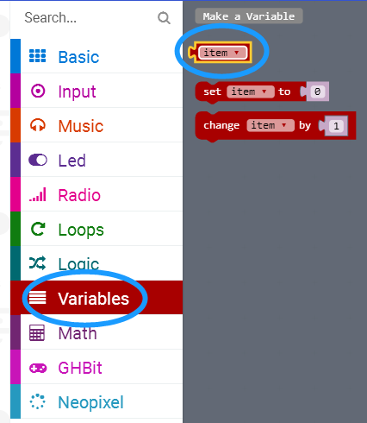
micro:bit programming tutorial
Part3
Indicates the size of the variable item value.
Yahboom micro:bit tutorial

Slide 14
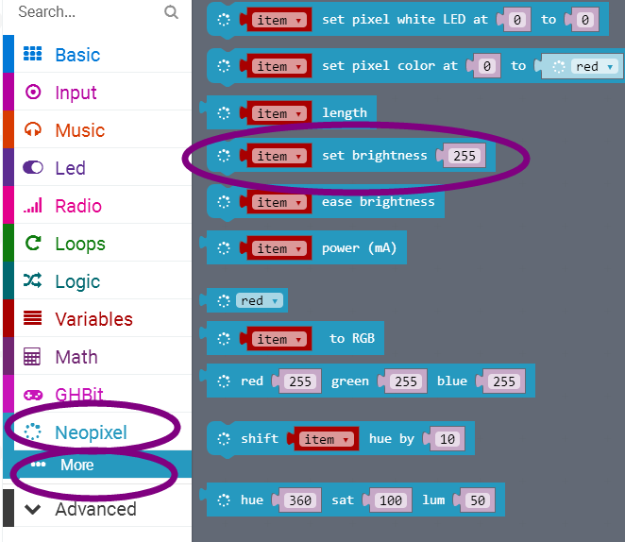
micro:bit programming tutorial
Part3
You can set the brightness of the colorful lights on the handle. The higher the number, the brighter the light, and the setting range of the numbers is 0 to 255.
Yahboom micro:bit tutorial

Slide 15
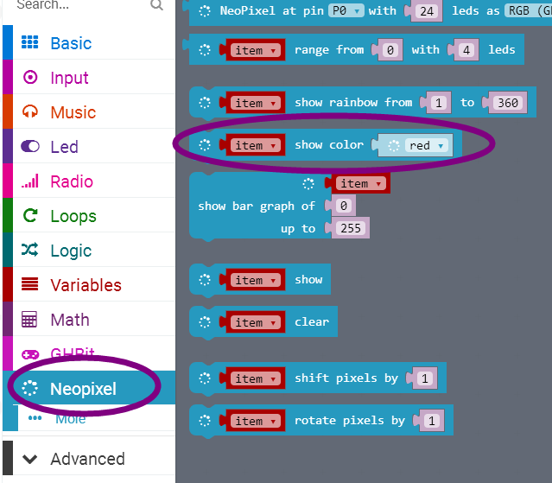
micro:bit programming tutorial
Part3
Set the color of the light and turn on the colorful lights ！
Yahboom micro:bit tutorial

Slide 16
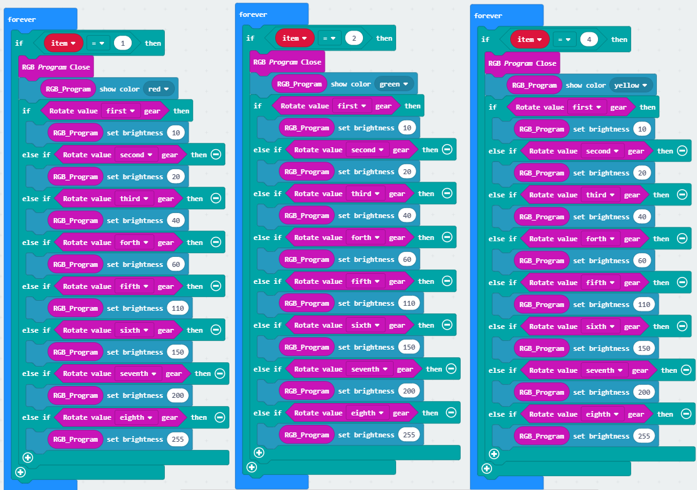
micro:bit programming tutorial
Next page
Part4
Yahboom micro:bit tutorial

Slide 17
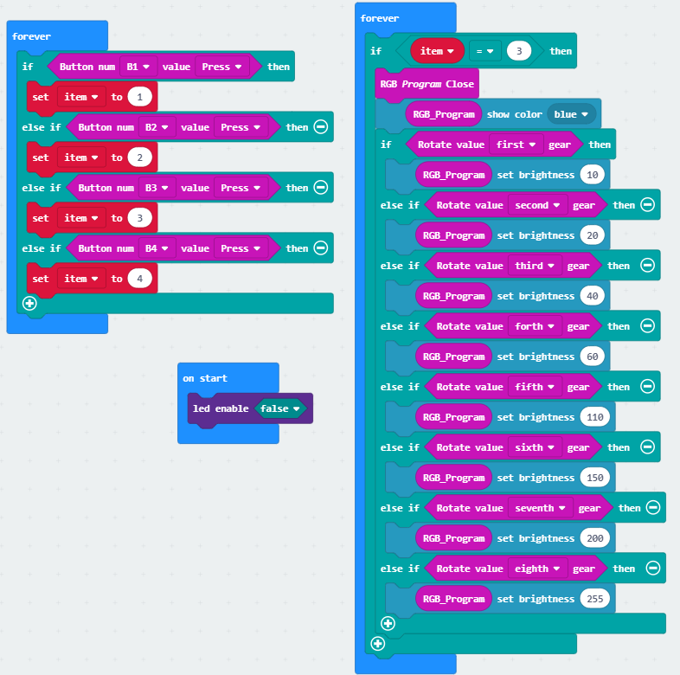
micro:bit programming tutorial
Part4
!Note:
Because the adjustable knob uses the P3 pin, the colorful running lights use the P4 pin, and they are multiplexed with the pins of the micro:bit dot matrix. So we need to turn off the LED during initialization.
This is the complete building block for this course, let's download it to the micro:bit Game Handle.
Yahboom micro:bit tutorial

Slide 18
micro:bit programming tutorial
Part5
Do you learn the course today?
If you learn to do it, give yourself a top quack.
Now give you a homework assignment.
Modify the program and change it to use the joystick to control the color change.
Start your little brain. Try it.
Yahboom micro:bit tutorial

Slide 19
micro:bit programming tutorial
micro:bit
Thanks for watching！
Yahboom
Yahboom micro:bit tutorial

